Slide 1
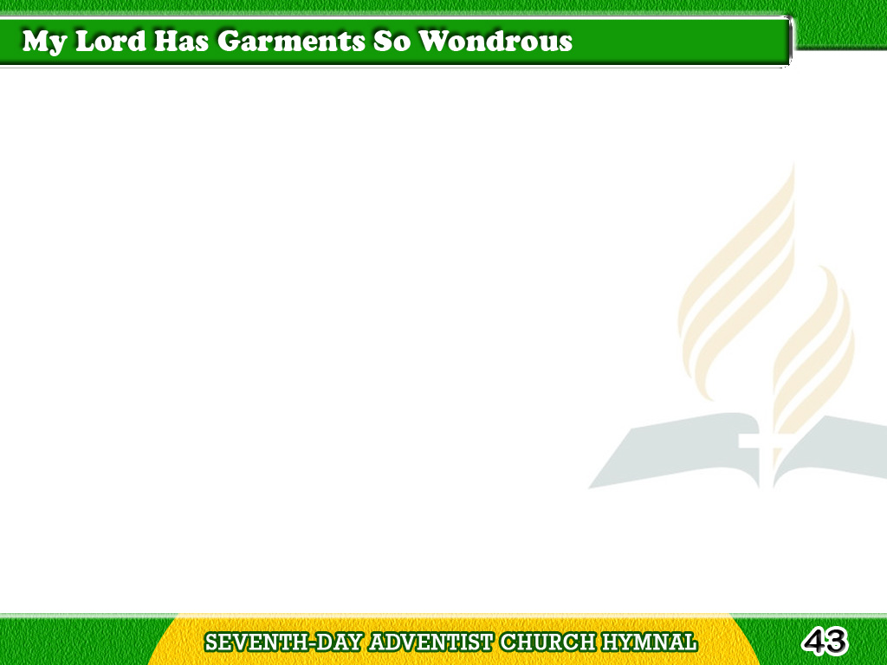
1/4
My Lord has garments
so wondrous fine,
And myrrh their texture fills;
Tagalog
Version

Slide 2
1/4
Its fragrance reached
to this heart of mine,
With joy my being thrills.
Tagalog
Version

Slide 3
1/4
Chorus
Out of the ivory palaces,
Into a world of woe,
Only His great eternal love…
Made my Saviour go.
Tagalog
Version

Slide 4
2/4
His life had also
its sorrows sore,
For aloes had a part;
Tagalog
Version

Slide 5
2/4
And when I think
of the cross He bore,
My eyes with teardrops start.
Tagalog
Version

Slide 6
2/4
Chorus
Out of the ivory palaces,
Into a world of woe,
Only His great eternal love
Made my Saviour go.
Tagalog
Version

Slide 7
3/4
His garments, too,
were in cassia dipped,
With healing in a touch;
Tagalog
Version

Slide 8
3/4
Each time my feet
in some sin have slipped,
He took me from each clutch.
Tagalog
Version

Slide 9
3/4
Chorus
Out of the ivory palaces,
Into a world of woe,
Only His great eternal love
Made my Saviour go.
Tagalog
Version

Slide 10
4/4
In garments glorious
He will come,
To open with the door;
Tagalog
Version

Slide 11
4/4
And I shall enter
my heav’nly home,
To dwell forever more.
Tagalog
Version

Slide 12
4/4
Chorus
Out of the ivory palaces,
Into a world of woe,
Only His great eternal love
Made my Saviour go.
Tagalog
Version

